Slide 1
Project 1 Predictive Analytics Course BAN 502
Student Name – Ravindra Aggarwal
Professor – Dr Stephen Hill

Slide 2
Agenda
Review Chicago Data Frame
Explain Data Mining Process
Clean Chicago Data frame
Put Visual Display on relation of predictor vs response ( “Arrest”)

Slide 3
Steps are being taken in Data preparation
Data Cleaning – Remove all NA and Missing data
Removed Rows with missing data
Created new data frame with Chicago_NA
Added new variables for Hours, Days, Minutes and Month of Crime incident
Removed 6 Variables ID,Case Number, Updated On, X Coordinate, Y Coordinate and Location
New Data frame (Chicago_NA) has only 20 variables.
Created a small data frame ( sample) with 100 rows, names Chicago_NA_Sample

Slide 4
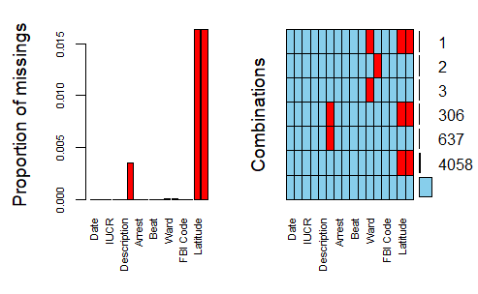
Cleaning the database.
After removing columns, there are 16 variables left in data set. Following variables have missing value
" Ward" = 4, "Community Area" = 2, Latitude and Longitude have 4365 observations missing.
All incident occurred in 2018.

Slide 5
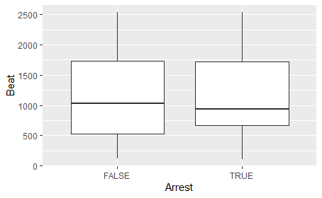
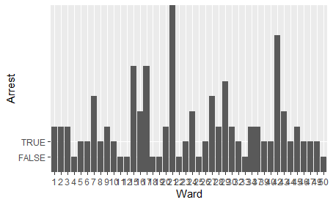
Exploratory Statics – Relationship of Response variable with Predictor Variables Beat and Ward.

Slide 6
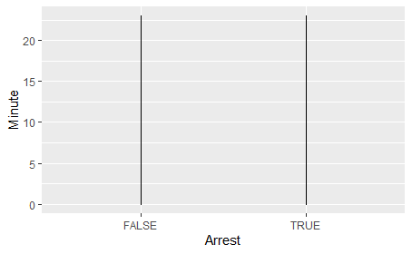
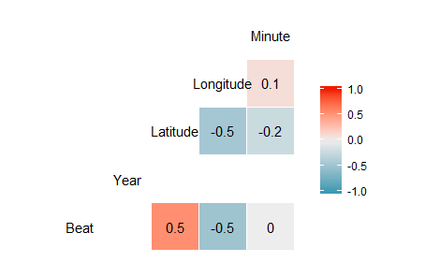
Exploratory Statics – Relationship of Response variable with Predictor Variables Minutes, Hours, District, FBI.
* Response Variable “Arrest” is Categorical variable so line chart and Histogram can not be applied to it
Not good correlation matrix

Slide 7
Conclusions
Response variable has “True” and “False” variables.
Since response variable is categorical, it is a example of logistic regression.
Data has been cleaned and no missing value.
Multiple libraries have been loaded.
Sample data frame with 100 rows have been created for easy of exploratory statics.
Variables have been converted into factors.
Multiple exploratory analysis done by using gg plots, Line, Box Plots, Bar Chart

